Slide 1
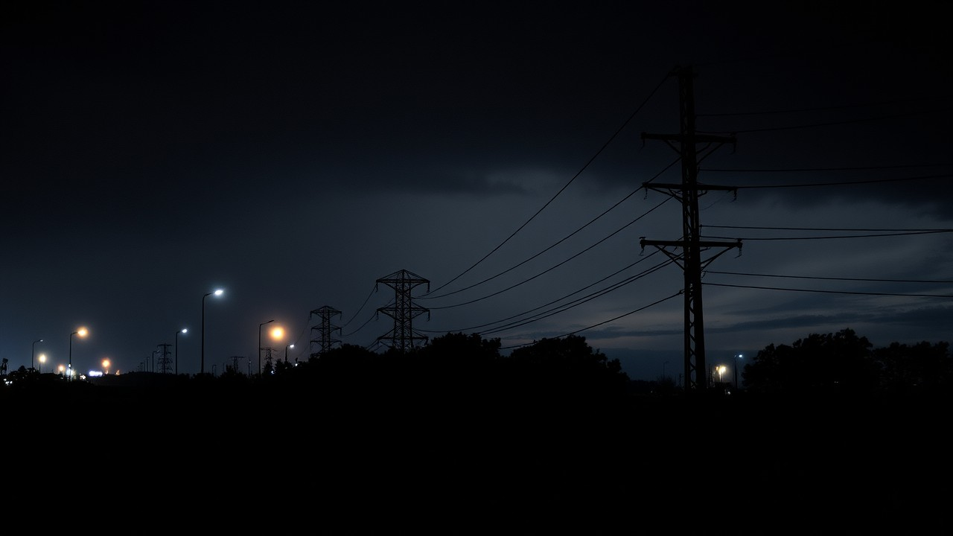
GridWatch
AI-Powered Early Warning System for
European Electricity Grid Stress
Team 6:
Chavely Albert Fernandez
Pedro Miguel da Câmara Leme
Ya-Chi Hsiao
Maria Sokotushchenko
Data Science Bootcamp neue fische & SPICED
Capstone Project 15.12.2025

Slide 2
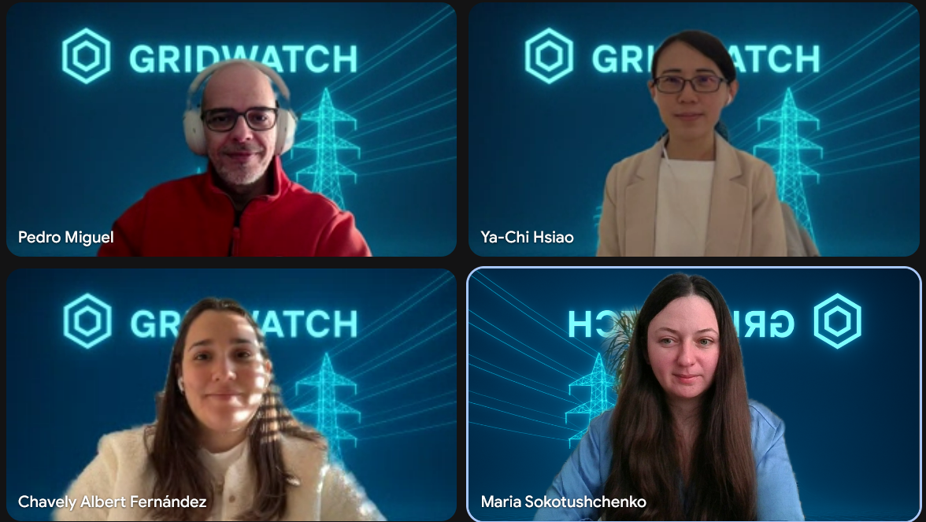
GridWatch Team
Notes:
On 28 April 2025, the power systems of Spain and Portugal suffered a massive blackout affecting tens of millions.
The incident demonstrates that even when generation capacity seems sufficient, systemic instabilities (voltage, synchronization) can trigger cascading failures.
This underlines that traditional capacity margin metrics might not always be enough — but also that generational/demand and imports data, combined with other factors, can still provide early warning signals.

Slide 3
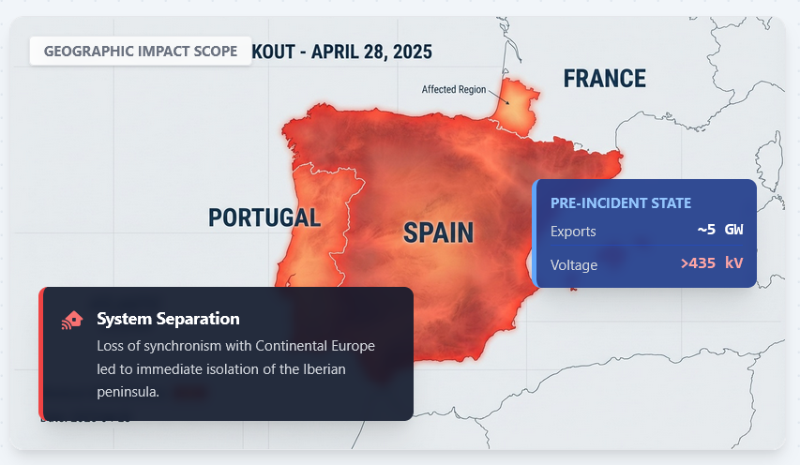

Overview
28 April 2025: Massive blackout across Spain and Portugal, impacting tens of millions
Showed that adequate generation doesn’t prevent voltage or synchronization instability
Proved that capacity margins alone are insufficient
Generation, demand, and import patterns can still provide early warning signals
Source: ENTSO-E Factual Report (Published Oct 3, 2025)
Our Goal: build a predictive model for “grid stress / blackout risk” using publicly available time-series data + machine learning.
Notes:
On 28 April 2025, the power systems of Spain and Portugal suffered a massive blackout affecting tens of millions.
The incident demonstrates that even when generation capacity seems sufficient, systemic instabilities (voltage, synchronization) can trigger cascading failures.
This underlines that traditional capacity margin metrics might not always be enough — but also that generational/demand and imports data, combined with other factors, can still provide early warning signals.

Slide 4

Data Overview
Load (Electricity Demand in MW- real time and day-ahead forecast)
10m wind speed (m/s)
2m air temperature (°C)
Generation by Source Type (real time and day-ahead forecast for wind offshore and solar)
Wind direction (degrees)
Cross-Border Flows (Physical electricity flows between countries in MW)
Surface solar radiation downwards (W/m²)
The European Network of Transmission System Operators for Electricity maintains the most comprehensive database of European grid operations.
January 2023 to October 2025 (2.8 years)
Total: ~590,000 country-hour observations
Notes:
Primary Data: ENTSO-E Transparency Platform
The European Network of Transmission System Operators for Electricity (ENTSO-E) maintains the most comprehensive database of European grid operations.
Geographic Coverage:
27 European countries: Spain, Portugal, France, Germany, Italy, United Kingdom, Netherlands, Belgium, Austria, Switzerland, Poland, Czech Republic, Denmark, Sweden, Norway, Finland, Greece, Ireland, Romania, Bulgaria, Hungary, Slovakia, Slovenia, Croatia, Estonia, Lithuania, Latvia
Temporal Coverage:
January 2023 to October 2025 (2.8 years)
Hourly resolution (24 records per day)
Total: ~590,000 country-hour observations

Slide 5


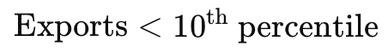
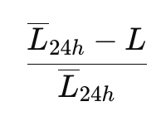
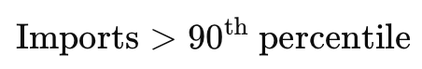
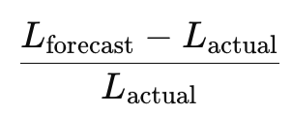
Data Preprocessing
Quantify real-time system stress using four operational indicators:
1. Reserve Margin
• ≥20% → 0 points
• 10–20% → 12.5 points
• <10% → 25 points
3. Cross-Border Exports
• Flag = 1 → 25 points
• Flag = 0 → 0 points
Target variable:
Grid Stress Score (0–100 points)
2. Load Forecast Error
• ≤3% → 0 points
• 3–10% → 12.5 points
• >10% → 25 points
4. Cross-Border Imports
• Flag = 1 → 25 points
• Flag = 0 → 0 points

Slide 6
Data Preprocessing
Time-based train/validation/test split
Dec 2024
Nov 2025
TRAIN
VALIDATION
TEST
Jan 2023
Jul 2025
13 countries:
AT DE HR BE PL HU LT NL FR ES IT PT SK

Slide 7
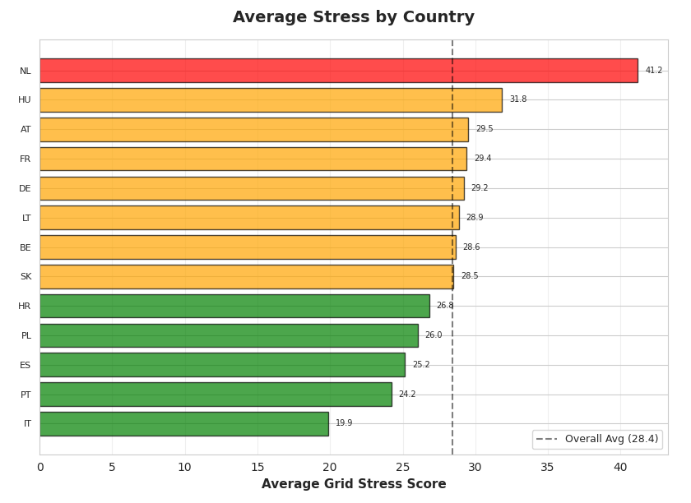
Some insights about grid stress
NL: high exports and large load forecast errors
Notes:
Chavely

Slide 8
Feature Engineering
Grid Features
(Operational Signals)
Electricity load
Imports / exports
Renewable energy output
Reserve margin
Weather Feature
(External Conditions)
Temperature
Wind speed
Weather variations
Time-Based Features
(Patterns Over Time)
Lags (1h, 24h)
Rolling trends (24h-mean, fluctuation level)
Hour / day / week patterns
Seasonal trends
Notes:
Ya-Chi’s Slide

Slide 9
Modeling
Time-series model - ARIMA
Machine learning models:
Regression Models
Linear Models: Linear / Ridge / Lasso
Decision Tree ( default / shallow)
Random Forests (default / deep / wide )
Gradient Boosting ( sklearn )
XGBoost ( default / deep / regularized )
LightGBM ( default / boosted )
Classification Models
Logistic Regression ( default / balanced )
Decision Tree Classifier ( default / balanced )
Random Forests Classifier ( default / balanced )
Gradient Boosting Classifier
XGBoost Classifier ( default / scale_pos_weight )
LightGBM Classifier
Notes:
Ya-Chi

Slide 10
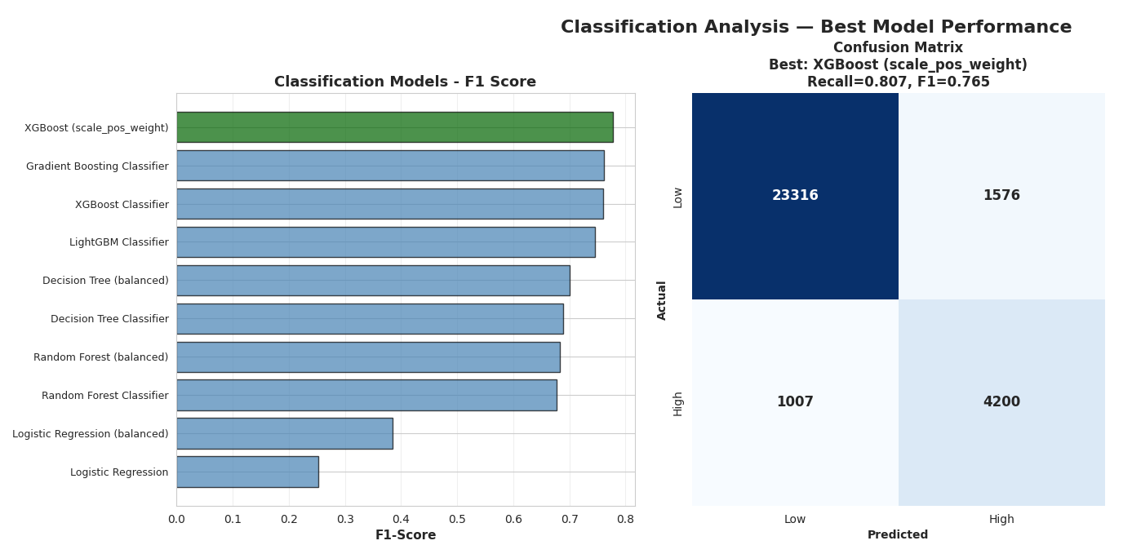

Classification Models
80% of the high grid stress situations are well predicted
Notes:
Pedro

Slide 11
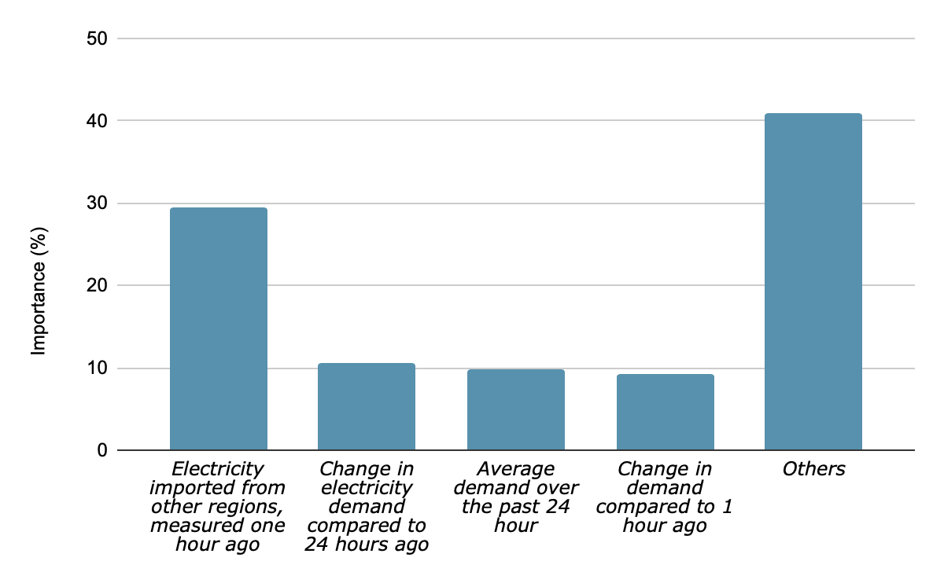
Which factors have the biggest impact on grid stress prediction?
Notes:
Pedro

Slide 12
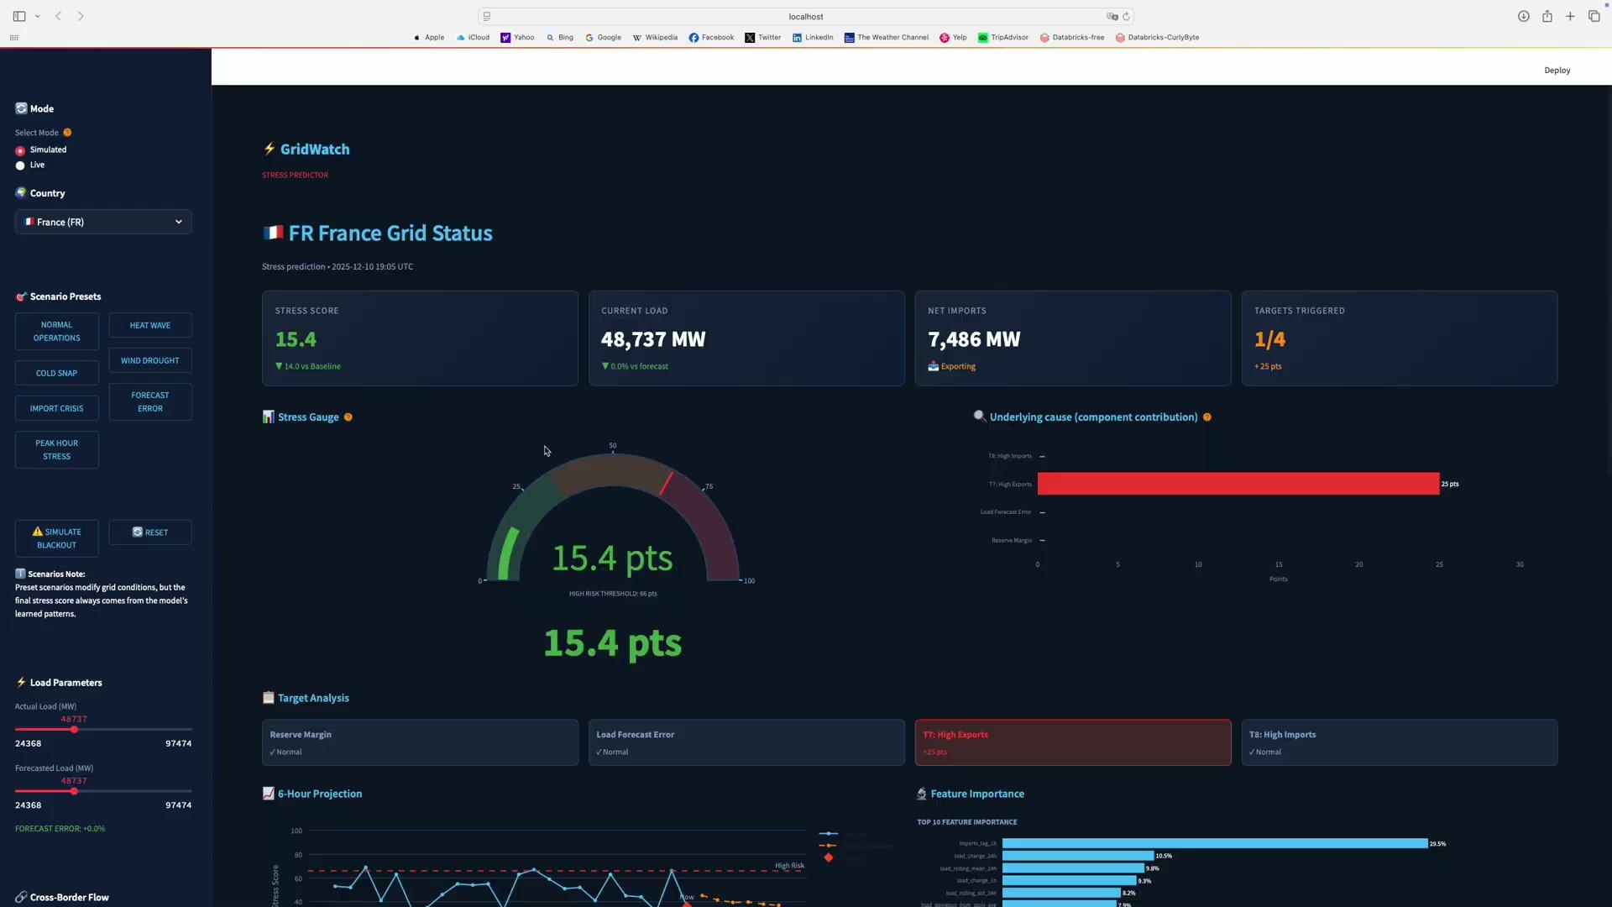
Notes:
Chavely

Slide 13


Thank you!
App:
https://gridwatch-energy-grid-stress-prediction.streamlit.app/
GitHub Repository: https://github.com/chavelyalbert/energy-grid-load-prediction

